Slide 1
Chaplain Orientation Brief
Henry "Ari" Soussan, PhD, Chaplain (Colonel), USA

Slide 2
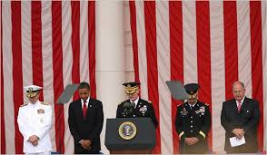
What you Need to Know
Ethics Program via Electives
Religious Support Program
Personal Resiliency

Slide 3
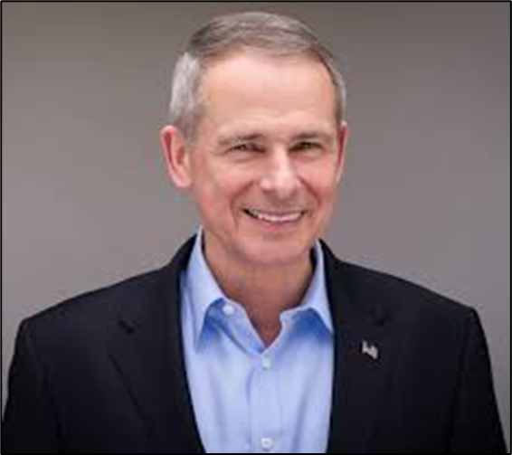
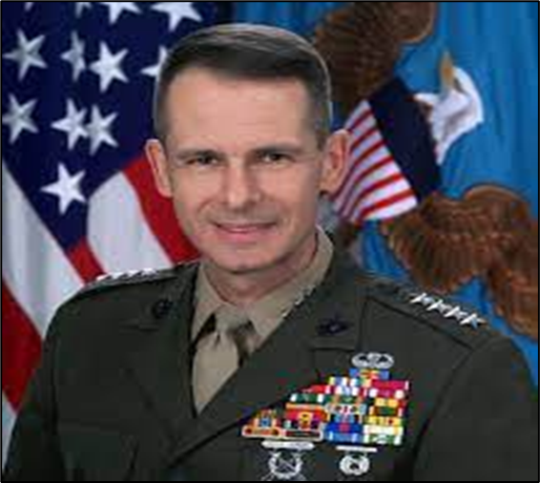
Ethics Program
NDU, Colin Powell Chair of Ethics
Ethics Roundtables
Ethics Concentration
Ethics Electives

Slide 4
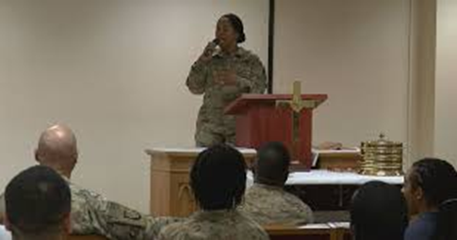
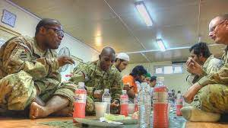
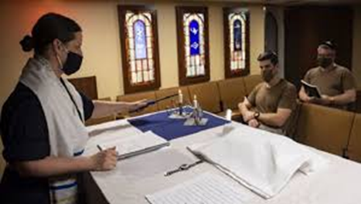
Religious Support Program
Religion matters
• Meditation Room: LH, Room 2320
• Prayer Breakfast
Counseling
*Watch for student updates sent to
your O365 email account.

Slide 5
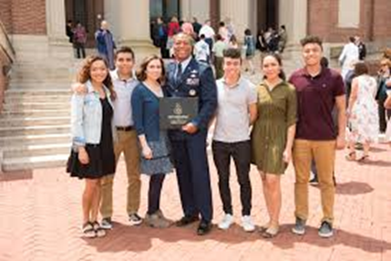
Personal Resiliency
Graduate!
Your goal
Some ideas:
- Positive Psychology
- Learn from every person
- Make encounters meaningful
- Embrace Diversity

Slide 6
Point of Contact
Henry "Ari" Soussan, PhD
Chaplain (Colonel), USA
The Eisenhower School
henry.c.soussan.mil@ndu.edu
Phone: 202 685-4191
Lincoln Hall, Room 2304

